Slide 1

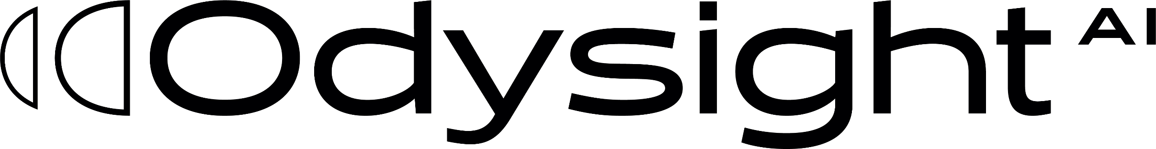
Predictive
Health Monitoring Systems
FROM VISUAL SENSOR TO INSIGHT

Slide 2
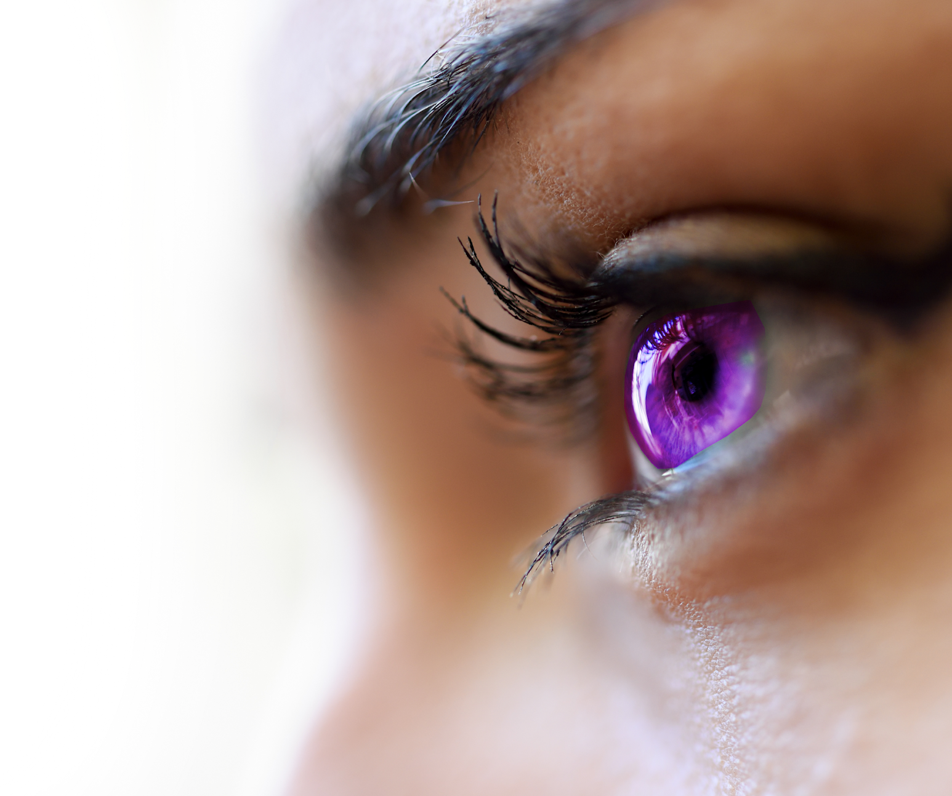

We see what others do not.
We perceive what others can not.
@2024 Odysight^{AI} Proprietary. All rights reserved. Confidential.
The power of vision |

Slide 3



Odysight^{AI} at-a-Glance
Founded in 2019
public traded company
$44M invested in the company’s technology
Located in Omer advance technology park (south of Israel)
Global pioneering leader in video analytics solutions for
critical I4.0 markets
@2024 Odysight^{AI} Proprietary. All rights reserved. Confidential.
Proven technology
for medical & space applications
Patents protected technology
The power of vision |
3

Slide 4

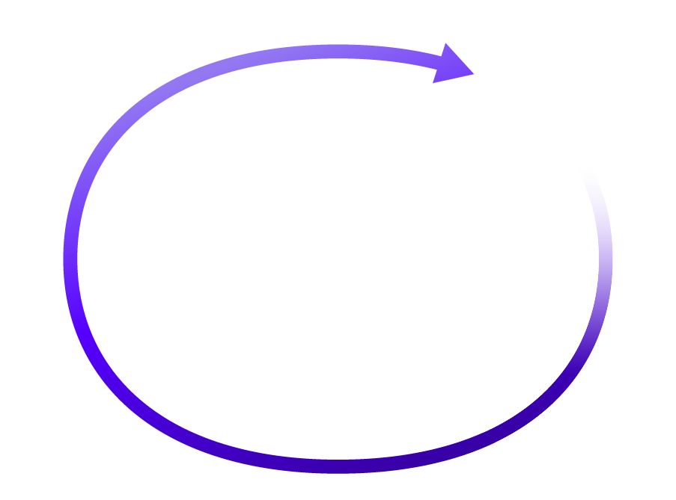

Solution Functional Flow
Predicting
Smart Sensor image acquisition
Real-Time continuous monitoring
Alerting
Cloud-based
@2024 Odysight^{AI} Proprietary. All rights reserved. Confidential.
AI\ML Processing
Analyzing
The power of vision |
@2023 Odysight^{AI} Proprietary. All rights reserved. Confidential.

